Slide 1
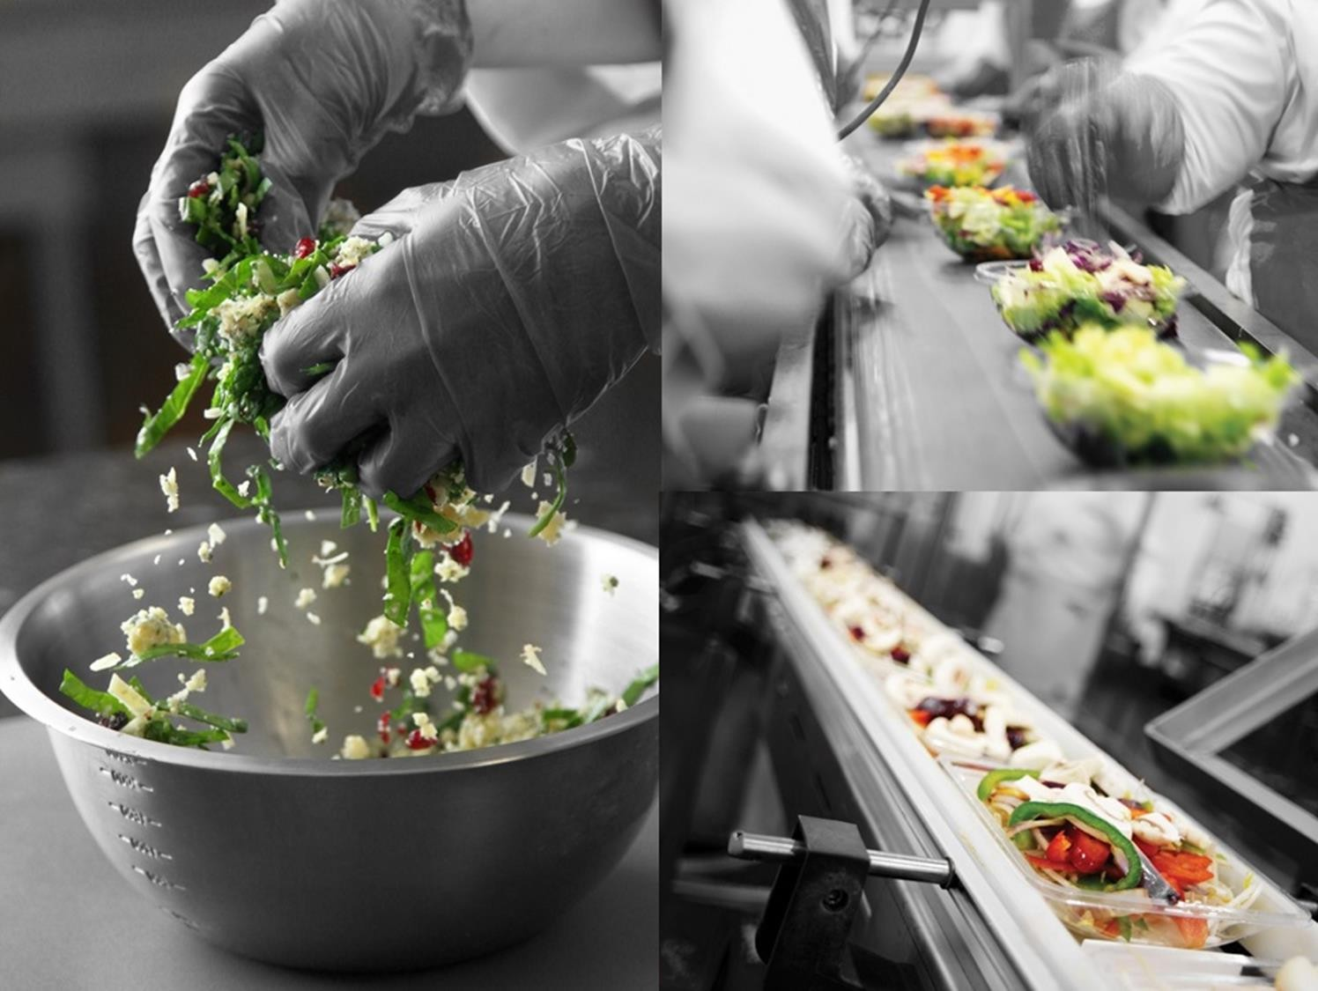

Gender Pay Gap 2025
Published 19/11/2025
The Gender Pay Gap Information Act 2021 refers to male and female employees.
Our report is based on this requirement, however, Nature’s Best Ltd is committed to inclusion of all gender identities.
Our pay and rewards practices are applied equally to everyone regardless of gender.

Slide 2
Nature’s Best Ltd is a second-generation family business.
We are the leading supplier to retailers of fresh leafy salads across the island of Ireland. Our employees are our most valuable asset, and our continued success is due to their continued hard work and dedication.
Our Vision
Fresh Food for Everyone – Everyday
F
Feed Everyone like Our Family
R
Respect in Every Engagement
Our Core FRESH Values
represent who we are and what we stand for as individuals and as a company.
E
Exceed Expectations
Our Mission
is to live our value each and everyday and ensure that our FRESH products are eaten everyday, in every household, by every person
S
Service, Quality and Value
H
Healthy Innovation

Slide 3
What is Gender Pay Gap Reporting
We are pleased to present our annual Gender Pay Gap (GPG) Report.
A gender pay gap shows the difference between Male and Female average hourly pay across an organisation regardless of their roles or industry sector.
The number, expressed as a percentage, can be affected by a range of factors including the different number of men and women across all roles.
A gender pay gap is different to an equal pay comparison.
Equal pay is a legal obligation that requires employers to give men and women equal pay for the same, similar, or equivalent work.
Median Pay Gap
The median represents the middle point of a population. Data is listed in order and the middle value is selected.
Mean Pay Gap
This shows the difference in average hourly pay rates between men and women and is directly affected by the different numbers of men and women in different roles
Gender Inclusion
The Gender Pay Gap Information Act 2021 refers to male and female employees.
Our report is based on this requirement, however, Nature’s Best Ltd is committed to the inclusion of all gender identities.
Nature’s Best Ltd sees all its employees as individuals, with varying, skills, experience, individual performance, and expertise. Our remuneration policy takes these factors into account. Our remuneration policy does not consider the gender of employees. Our pay and rewards practices are
applied equally to everyone regardless of gender.

Slide 4
Median and Mean Results
20%
Median Hourly Remuneration Gap
6%
Mean Hourly Remuneration Gap
Median Part-Time Remuneration Gap
-38%
Mean Part-Time Remuneration Gap
-75%
Median Bonus Remuneration Gap **
N/A
N/A
Mean Bonus Remuneration Gap **
N/A
Median Temporary Hourly Remuneration Gap*
*We did not have any temporary Employees during the
Snap-Shot
N/A
Mean Temporary Hourly Remuneration Gap*
**We did not have any bonuses paid in 2025

Slide 5
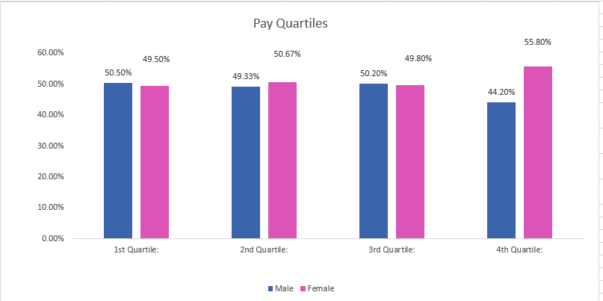
% of Employees Receiving Bonus Payments**
0% 0%
% of Employees Receiving BIK Payments
Pay Quartiles
10.8%
3.4%
*We did not have any temporary Employees during the
Snap-Shot
**We did not have any bonuses paid in 2025

Slide 6
2025 Findings
The Median Hourly Remuneration Gap has increased from 9.3% to 20%. This reflects an increase in mid to senior roles. Notwithstanding this, we have seen a decrease in the Mean Hourly Remuneration Gap year on year from 8.2% to 6%. This has been as a result of a number of factors. Some key Senior employees changed throughout the year and the gender upon re hire of these roles changed.
The Median Part-Time Remuneration Gap has increased from 0% to -38%. This reflects a shift in the working patterns by a number of female employee’s facilitating a work life balance. As a result of this shift in work patterns, our mean has also increased from -1% to -75%. This also reflects the employee’s who held senior positions and moved from full-time to part-time working hours.
All employees are recruited based on non-gender basis. Nature’s Best Ltd is an inclusive and equal opportunities employer. Nature’s Best Ltd is committed to recruiting the right person for the role regardless of gender.
Quartile Analysis
The 1st and 2nd Quartiles have seen an increase in female representation as a result of our recent recruitment drive in comparison to 2024 results. This trend follows through to the 3rd & 4th Quartiles, as employee’s have the same split in percentage on average and the large majority of the employees are hourly paid for the same roles. With the increase in female hires the pay gap in these quartiles have decreased.
Our Action Plan
We remain confident that all genders in our organisation are paid equally for doing equivalent jobs across our business. Our plan for 2026 will be to further progress our gender pay gap action plan, maintaining our focus on representation of all genders and ensuring flexibility and inclusive leadership are key priorities.

Slide 7
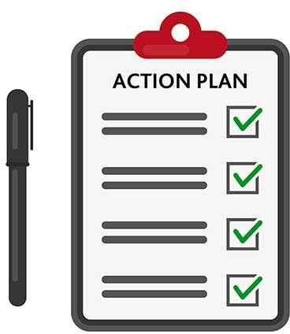
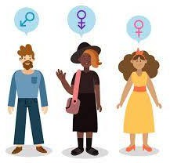


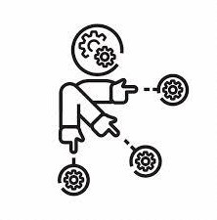
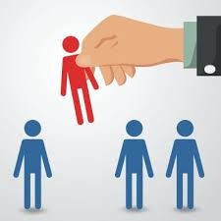

Our Action Plan
Building Inclusive Mindsets
We will develop our people not only with unconscious bias training but by offering learning pathways to develop an inclusive mindset that can be applied to everything we do.
Learning and Development
We will continue to develop our talent and ensure we have a gender balanced and inclusive mix of talent attending development programmes.
Talent Acquisition
Talent Acquisition: We continually review our recruitment processes to ensure we are open and attractive to all.
Allocation of work:
We are putting a laser focus on providing equal opportunities for career enhancing roles and reviewing the gender balance on key engagements.
Focus on appraisal and reward:
We will continue to apply a diversity lens to our appraisal and reward process, using data to provide insight and support decision making.
Data Driven Approach:
We will continue to take a data driven approach to building an inclusive culture, ensuring we have the right data and appropriate internal targets where needed to drive change

